Slide 1
Transaction Management

Slide 2
Transaction represents a single unit of work.
The ACID properties describes the transaction management well. ACID stands for Atomicity, Consistency, isolation and durability.
Atomicity means either all successful or none.

Slide 3
Consistency ensures bringing the database from one consistent state to another consistent state.
Isolation ensures that transaction is isolated from other transaction.
Durability means once a transaction has been committed, it will remain so, even in the event of errors, power loss etc.

Slide 4
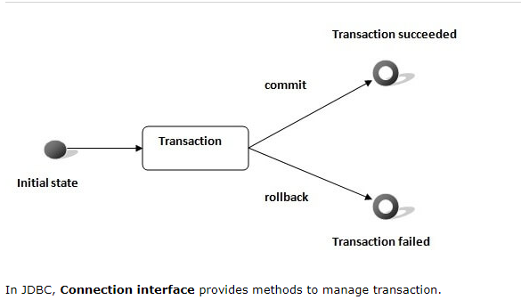

Slide 5
Simple example of transaction management in jdbc using Statement
import java.sql.*;
class FetchRecords{
public static void main(String args[])throws Exception{
Class.forName("oracle.jdbc.driver.OracleDriver");
Connection con=DriverManager.getConnection("jdbc:oracle:thin:@localhost:1521:xe",“dbName",“password");
con.setAutoCommit(false);
Statement stmt=con.createStatement();

Slide 6
stmt.executeUpdate("insert into user420 values(190,'abhi',40000)");
stmt.executeUpdate("insert into user420 values(191,'umesh',50000)");
con.commit();
con.close();
}}

Slide 7
Example of transaction management in jdbc using PreparedStatement
import java.sql.*;
import java.io.*;
class TM{
public static void main(String args[]){
try{
Class.forName("oracle.jdbc.driver.OracleDriver");
Connection con=DriverManager.getConnection("jdbc:oracle:thin:@localhost:1521:xe","system","oracle");
con.setAutoCommit(false);
PreparedStatement ps=con.prepareStatement("insert into user420 values(?,?,?)");

Slide 8
BufferedReader br=new BufferedReader(new InputStreamReader(System.in));
while(true){
System.out.println("enter id");
String s1=br.readLine();
int id=Integer.parseInt(s1);
System.out.println("enter name");
String name=br.readLine();
System.out.println("enter salary");
String s3=br.readLine();
int salary=Integer.parseInt(s3);

Slide 9
ps.setInt(1,id);
ps.setString(2,name);
ps.setInt(3,salary);
ps.executeUpdate();
System.out.println("commit/rollback");
String answer=br.readLine();
if(answer.equals("commit")){
con.commit();
}
if(answer.equals("rollback")){

Slide 10
con.rollback();
}
System.out.println("Want to add more records y/n");
String ans=br.readLine();
if(ans.equals("n")){
break;
}
}

Slide 11
con.commit();
System.out.println("record successfully saved");
con.close();//before closing connection commit() is called
}catch(Exception e){System.out.println(e);}
}}

